Slide 1

MAJOR PROJECT SESSION: 2024-25
Shri Shankaracharya Professional University
Bhilai (C.G.)
Establishment Under Chhattisgarh Private Universities
(Establishment And Operation) Act, 2005
“Real Property Dealing Project”
GUIDED BY PREPARED BY
Asst. Professor Heena Kausar Mam ANKIT KUMAR DEWANGAN

Slide 2
TABLE OF CONTENTS:-
Introduction
Software Requirements
Architecture / Flow Diagram
Methodology / Working
Conclusion

Slide 3
INTRODUCTION:-
This Software Requirements Specification (SRS) document defines the functionality and requirements of
the SmartE website, a web platform that allows employees to register, log their attendance, apply for
leaves, and track their work details. The website is developed using ReactJS for the frontend and Python
Django for the backend.
Purpose :
The purpose of this website is to streamline employee management by providing a centralized platform
for attendance logging, leave management, departmental assignments, and salary calculations based on
attendance and leave records.

Slide 4
SOFTWARE REQUIREMENTS:-
Hardware:-
Window 11 , Ram
Backup Devices
Software:-
Frontend:
Html
Css
javascript
React.js
Antd
Bootstrap
Backend
Python
Django(Framwork)
Artificial Intelligence
Database
MySQL

Slide 5
ARCHITECTURE / FLOW DIAGRAM:-

Slide 6
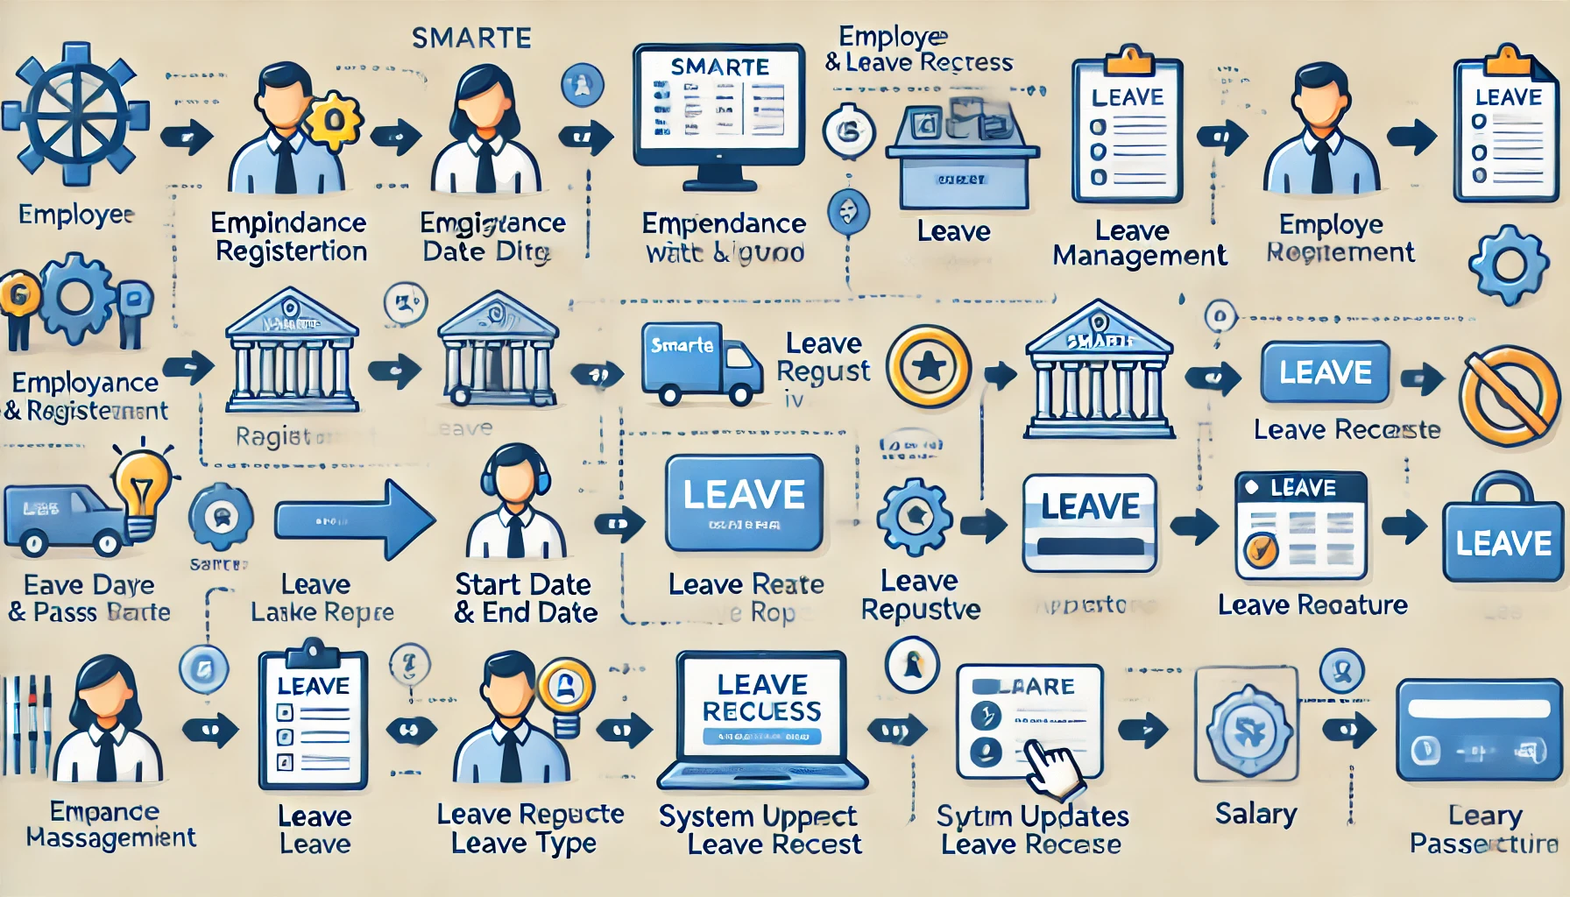
METHODOLOGY / WORKING:-

Slide 7
CONCLUSION :-
This SRS document outlines the key features and requirements for the SmartE website, aimed at
overseeing employee attendance, leave applications, and salary calculations. With ReactJS for the
frontend and Python Django for the backend, the website will provide an efficient, user friendly platform
for both employees and managers to streamline HOD processes. The addition of an AI powered Employee
Help Chatbot will further enhance the user experience by offering quick, accurate responses to employee
queries and providing personalized notifications.
NT SP

Slide 8


